Slide 1
Sales Comparisons by Region
Comparison of Region Based on Sales
Course-end Project 2
By Priyambada Anand

Slide 2
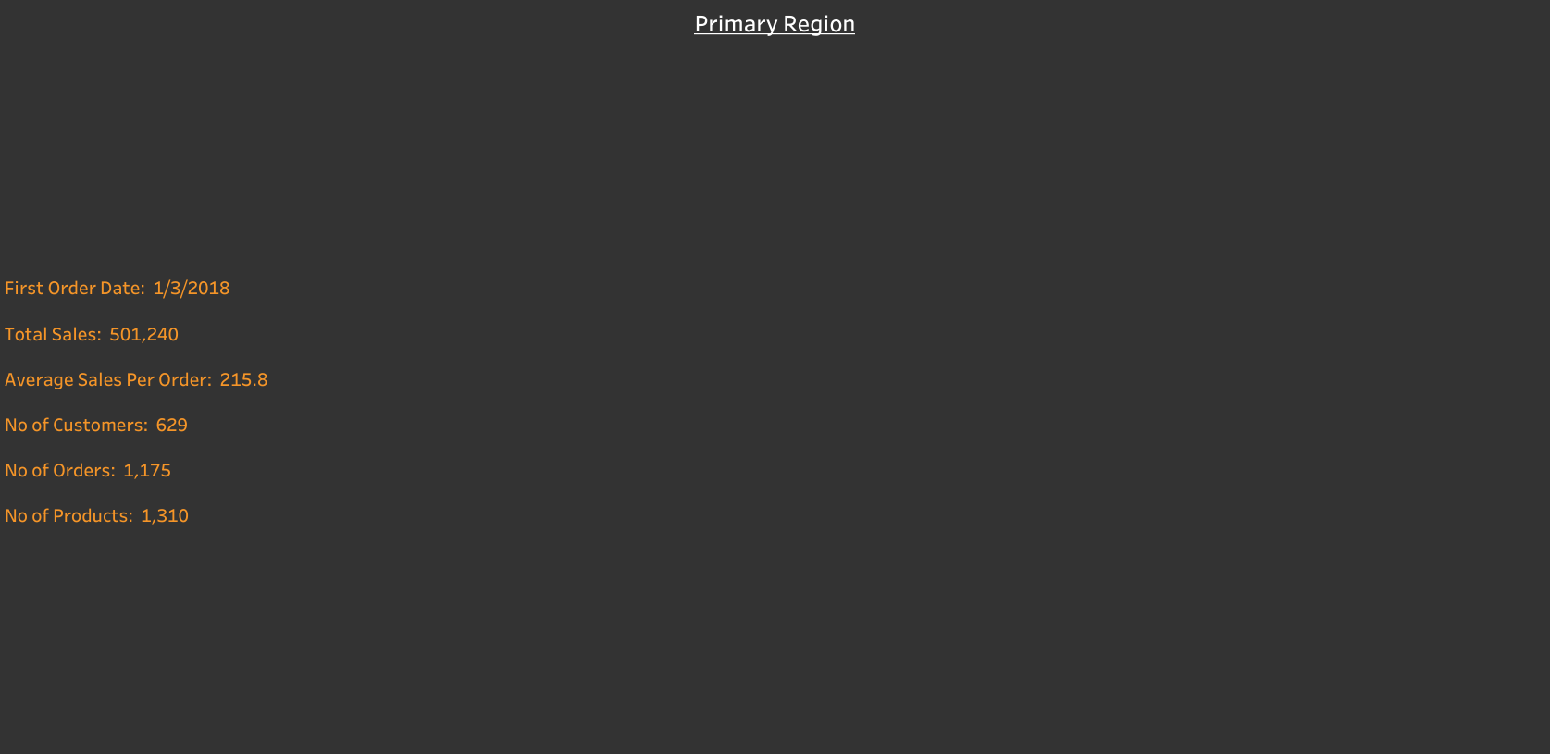

Slide 3


Slide 4
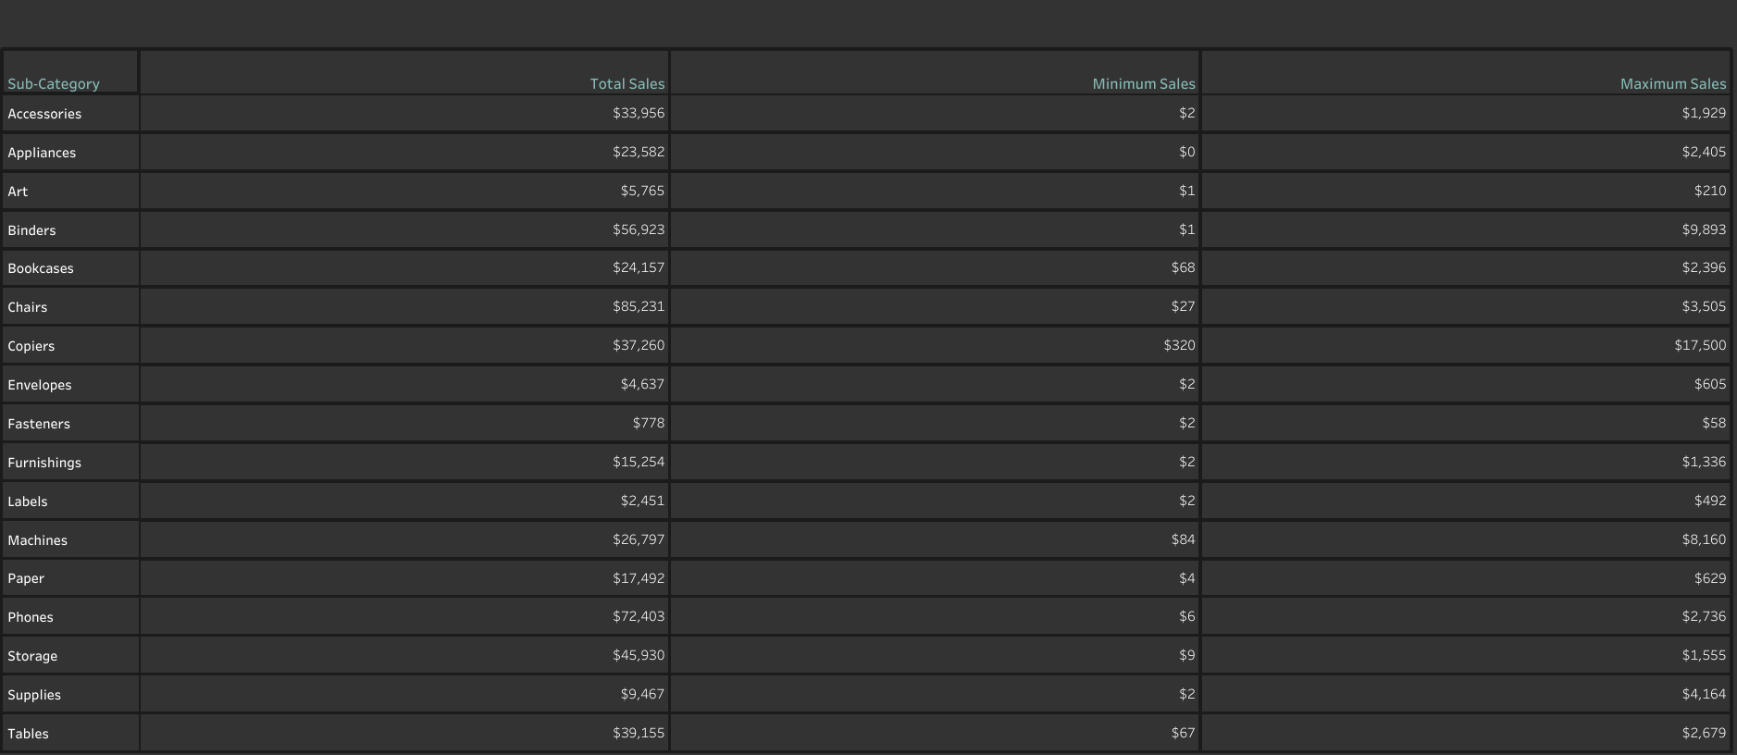

Slide 5
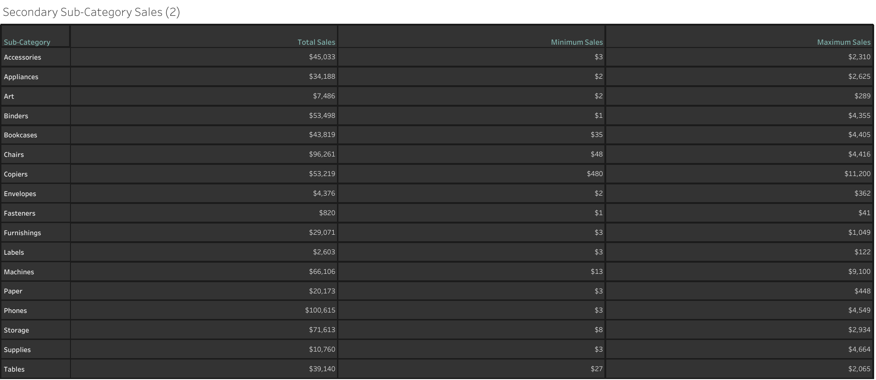

Slide 6
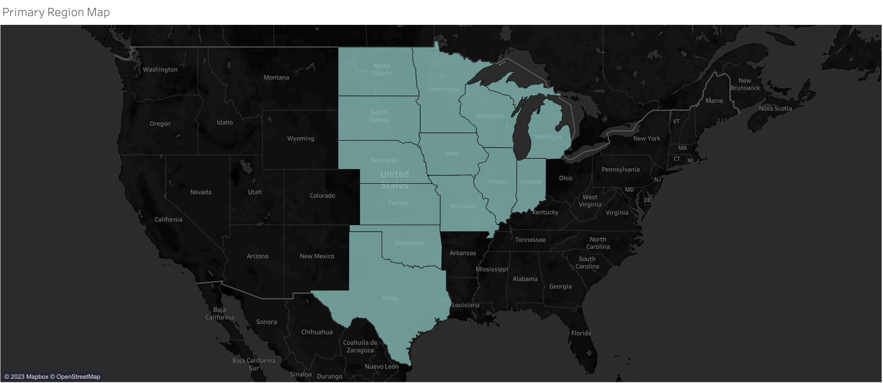

Slide 7
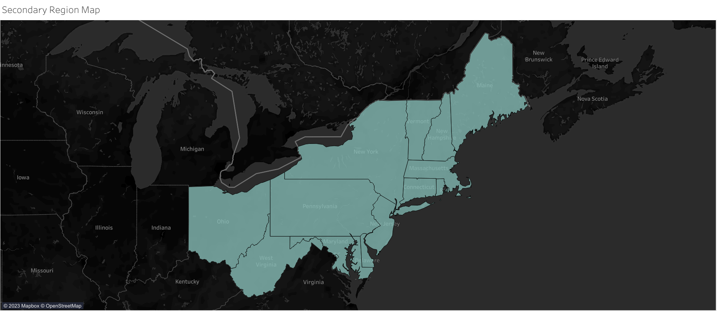

Slide 8
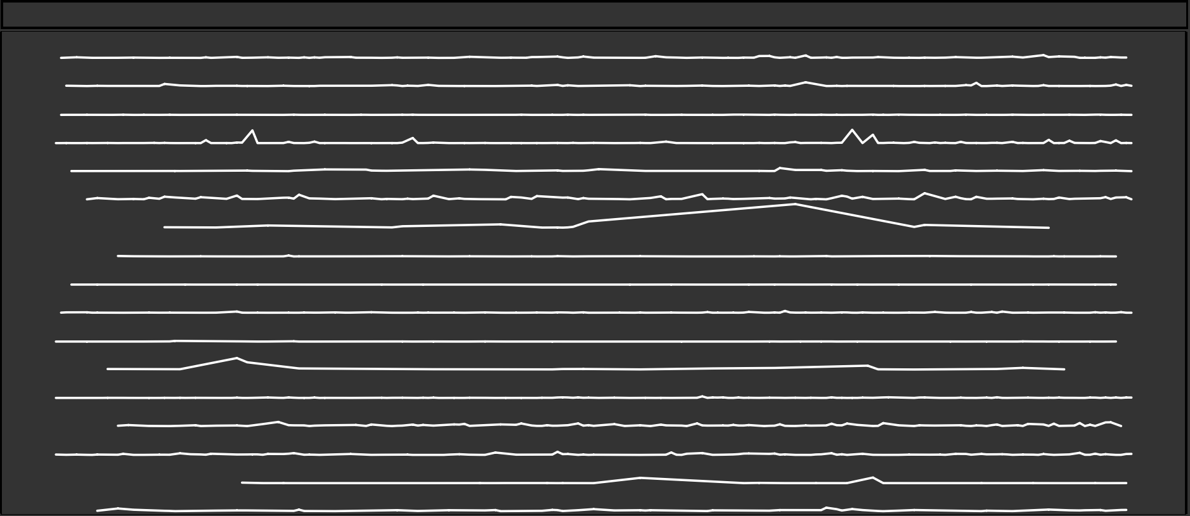

Slide 9
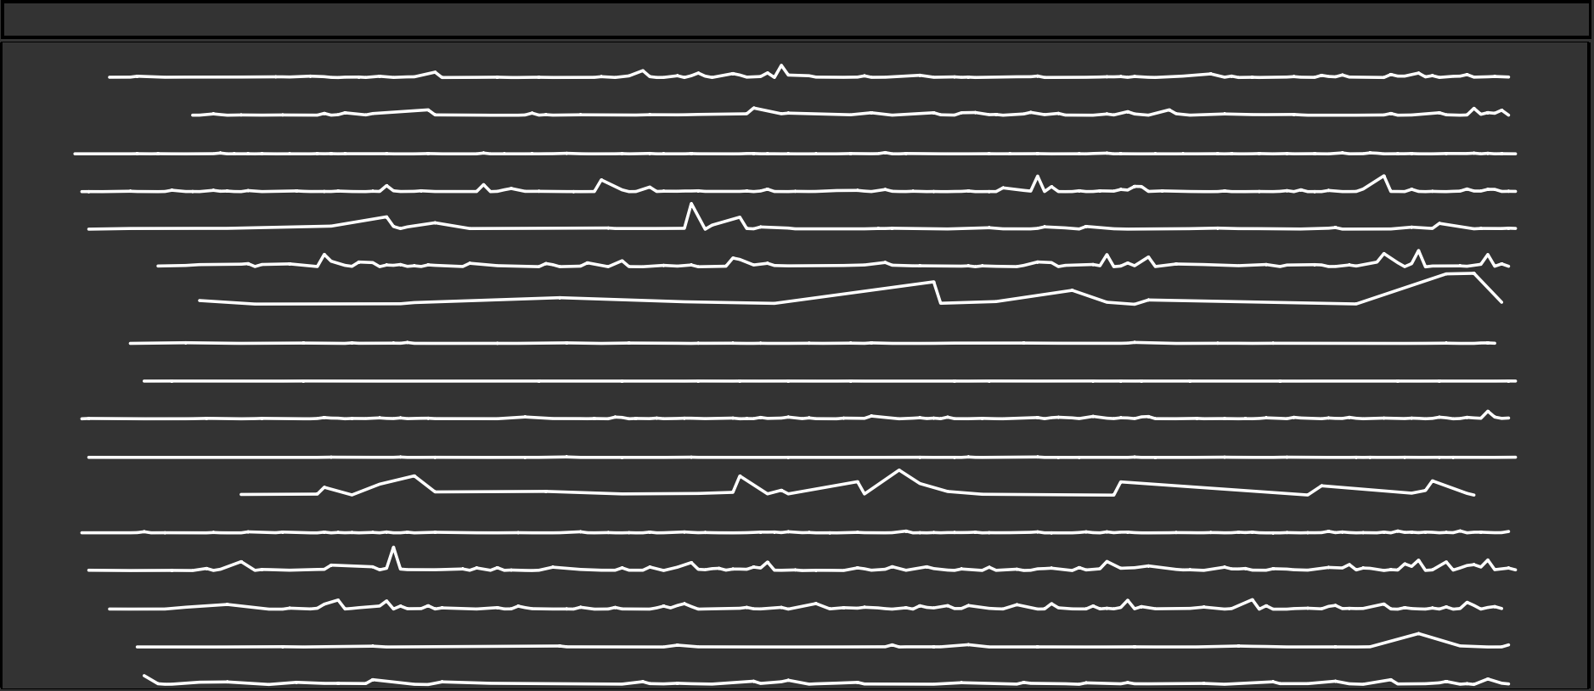

Slide 10


Slide 11


Slide 12
